Slide 1
Unit-5 Exception Handling & Multithreading

Slide 2
Abstract
Purpose of Exception
Exception Handling Mechanism
User defined Exception

Slide 3
Purpose of Exception Handling
Reduce the chance of system crash or unexpected termination of the program.
Provide specific information about errors to the users

Slide 4
Exception Handling Mechanism
There are 5 keywords used in java exception handling.
try
catch
finally
throw
throws

Slide 5
Try…catch block
A method catches an exception using a combination of the try and catch keywords.
A try/catch block is placed around the code that might generate an exception or errors.
The syntax for using try/catch block:

Slide 6
Try…catch block
try
{
// code
}
catch(ExceptionName e1)
{
// Catch block
}

Slide 7
Try…catch block
Try block:
Java try block is used to enclose the code that might throw an exception.
Java try block must be followed by either catch or finally block.
Catch block:
Java catch block is used to handle the Exception. It must be used after the try block only.
You can use multiple catch block with a single try.

Slide 8
Try…catch block
Example:
Suppose, an array declared with 5 elements. Then the code tries to access the 7th element of the array which throws an exception.

Slide 9
import java.io.*;
public class First
{
public static void main(String args[])
{
try
{
int a[] = new int[5];
System.out.println("Access element seven:" + a[7]);
}
catch (ArrayIndexOutOfBoundsException e1)
{
System.out.println("Exception thrown :" + e1);
}
System.out.println("Out of the block");
}}

Slide 10
Output ?????

Slide 11
Multiple Catch Block
try
{
// Protected code
}
catch(ExceptionType1 e1)
{
// Catch block
}
catch(ExceptionType2 e2)
{
// Catch block
}
catch(ExceptionType3 e3)
{
// Catch block
}

Slide 12
Multiple Catch Block
Any number of catch block use in single try.
If an exception occurs in the protected code, the exception is thrown to the first catch block in the list.
If the data type of the exception thrown matches ExceptionType1, it gets caught there.

Slide 13
Multiple Catch Block
If not, the exception passes down to the second catch statement.
This continues until the exception either is caught or falls through all catches, in which case the current method stops execution and the exception is thrown down to the previous method on the call stack.

Slide 14
Multiple Catch Block
public class TestMultipleCatchBlock
{
public static void main(String args[])
{
try{
int a[]=new int[5];
a[5]=30/0;
}
catch(ArithmeticException e)
{System.out.println("task1 is completed");}
catch(ArrayIndexOutOfBoundsException e)
{System.out.println("task 2 completed");}
catch(Exception e)
{System.out.println("common task completed");}
}
}

Slide 15
Nested try block
Sometimes a situation may arise where a part of a block may cause one error and the entire block itself may cause another error. In such cases, exception handlers have to be nested.
The try block within a try block is known as nested try block in java.

Slide 16
Nested try block
try
{
statement 1;
statement 2;
try
{
statement 1;
statement 2;
}
catch(Exception e)
{
}
}
catch(Exception e)
{
}
....

Slide 17
Nested try block
class Nested_try
{
public static void main(String args[])
{
try
{
try
{
System.out.println("going to divide");
int b =39/0;
}
catch(ArithmeticException e){System.out.println(e);}
try
{
int a[]=new int[5];
a[5]=4;
}
catch(ArrayIndexOutOfBoundsException e)
{System.out.println(e);}
}
}

Slide 18
Output?????

Slide 19
finally block
Java finally block is a block that is used to execute important code such as closing connection, stream etc. It’s generally term as clean up processing.
Java finally block is always executed whether exception is handled or not.
Java finally block follows try or catch block.

Slide 20
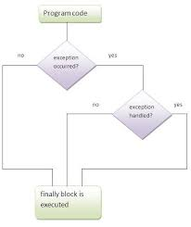
finally block

Slide 21
finally block
class TestFinallyBlock{
public static void main(String args[]){
try{
int data=25/5;
System.out.println(data);
}
catch(NullPointerException e)
{System.out.println(e);}
finally
{System.out.println("finally block is always executed");}
}
}

Slide 22
finally block
class TestFinallyBlock1{
public static void main(String args[]){
try{
int data=25/0;
System.out.println(data);
}
catch(NullPointerException e)
{System.out.println(e);}
finally
{System.out.println("finally block is always executed");}
}
}

Slide 23
Output????

Slide 24
Throw and throws
If a method does not handle a checked exception, the method must declare it using the throws keyword. The throws keyword appears at the end of a method's signature.
You can throw an exception, either a newly instantiated one or an exception that you just caught, by using the throw keyword.

Slide 25
Throw keyword
The Java throw keyword is used to explicitly throw an exception.
We can throw either checked or unchecked exception in java by throw keyword. The throw keyword is mainly used to throw custom exception.
Syntax:
throw ThrowableInstance;
here, throwable instance is the object type of Throwable class.

Slide 26
Throw keyword
There are two possible ways to create an instance of class Throwable,
Using a parameter in catch block.
Creating instance with new operator.
In the below example the avg() method throw an instance of ArithmeticException, which is successfully handled using the catch statement and thus, the program outputs "Exception caught".

Slide 27
Throw keyword
class Test {
static void avg()
{
try
{
throw new ArithmeticException("demo");
}
catch(ArithmeticException e)
{ System.out.println("Exception caught");
}
}
public static void main(String args[])
{
avg();
} }

Slide 28
Throws keyword
Any method that is capable of causing exceptions must list all the exceptions possible during its execution, so that anyone calling that method gets a prior knowledge about which exceptions are to be handled. A method can do so by using the throws keyword.
Syntax :
type method_name(parameter_list) throws exception_list
{
//body of the method
}

Slide 29
Throws keyword
class Test {
static void check() throws ArithmeticException
{
System.out.println("Inside check function");
throw new ArithmeticException("demo");
}
public static void main(String args[])
{
try
{ check(); }
catch(ArithmeticException e) { System.out.println("caught" + e); }
} }

Slide 30
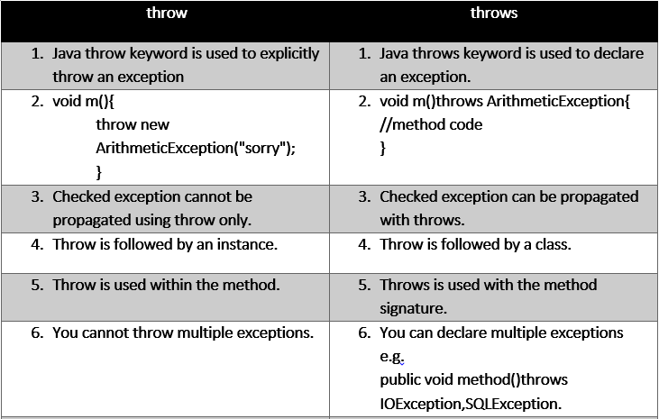
Difference: Throw Vs. Throws Keyword

Slide 31
User defined Exception
In java we have already defined, exception classes such as ArithmeticException, NullPointerException etc. These exceptions are already set to trigger on pre-defined conditions such as when you divide a number by zero it triggers ArithmeticException.
JAVA facilitate to create your own Exception that is known as custom exception or user-defined exception. Java custom exceptions are used to customize the exception according to user need.
By the help of custom exception, you can have your own exception and message.

Slide 32
User defined Exception
class MyException extends Exception {
private int ex;
MyException(int a) { ex=a; }
public String toString()
{ return "MyException[" + ex +"] is less than zero"; } }
class Test {
static void sum(int a,int b) throws MyException {
if(a<0) {
throw new MyException(a);
//calling constructor of user-defined exception class }
else {
System.out.println(a+b); } }

Slide 33
User defined Exception
public static void main(String[] args)
{
try {
sum(-10, 10);
}
catch(MyException me)
{
System.out.println(me); //it calls the toString() method of user-defined Exception
} } }

Slide 34
Multithreading
Multithreading in java is a process of executing multiple threads simultaneously.
Thread is basically a lightweight sub-process, a smallest unit of processing. Multiprocessing and multithreading, both are used to achieve multitasking.
But we use multithreading than multiprocessing because threads share a common memory area. They don't allocate separate memory area so saves memory, and context-switching between the threads takes less time than process.
Java Multithreading is mostly used in games, animation etc.

Slide 35
Thread life cycle
A thread can be in one of the five states. According to sun, there is only 4 states in thread life cycle in java new, runnable, non-runnable and terminated. There is no running state.
But for better understanding the threads, we are explaining it in the 5 states.
The life cycle of the thread in java is controlled by JVM. The java thread states are as follows:
New
Runnable
Running
Non-Runnable (Blocked)
Terminated

Slide 36
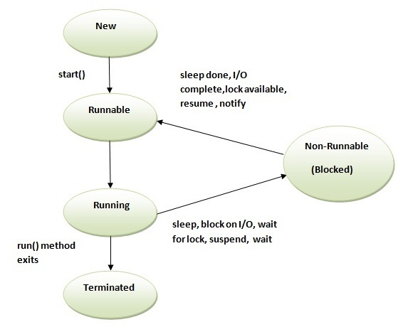
Thread life cycle

